Slide 1
Media & Interactivity in Web Design

Slide 2
Media and Interactivity Basics
Definition of multimedia: images, video, audio, graphics, animations
Role in enhancing user engagement and information delivery
Usability vs aesthetics: maintaining balance in design
Impact on UX: cognitive load, emotional engagement, and navigation flow
Interactivity as a key component in modern web applications

Slide 3
Types of Media Used in Web Design
Raster Images (JPEG, WebP, PNG): best for photographs
Vector Images (SVG): best for icons and scalable graphics
Audio (MP3, AAC, WAV): background audio, podcasts, narration
Video (MP4, WebM): tutorials, demos, promotional visuals
Interactive Media (Canvas, WebGL, animations)

Slide 4
Image Optimization Techniques – Why It Matters
Improves page load speed and performance
Reduces server bandwidth usage
Direct impact on SEO and Core Web Vitals
Enhances user satisfaction and reduces bounce rates

Slide 5
Image Optimization Techniques – Methods
Choosing the right format: WebP & AVIF for modern optimization
Responsive images: using <img srcset> and <picture> for size variation
Lossy vs lossless compression: selecting based on quality requirements
Tools: TinyPNG, Squoosh, ImageMagick, Photoshop
Lazy loading: using loading='lazy' attribute to defer off‑screen images

Slide 6
Video & Audio Integration in Web Development
HTML5 <video> and <audio> elements and essential attributes
Video codecs (H.264, VP9) and audio codecs (AAC, MP3)
Accessibility features: captions, transcripts, audio descriptions
Streaming solutions: HLS, DASH for adaptive streaming
Embedding external platforms: YouTube, Vimeo, SoundCloud

Slide 7
Best Practices for Video & Audio
Avoid autoplay; provide user control
Use optimized video sizes to prevent page lag
Provide fallback formats for browser compatibility
Use poster images for video placeholders
Ensure keyboard accessibility for controls

Slide 8
Introduction to SVG Graphics
Scalable Vector Graphics: XML-based image format
Advantages: resolution independence, small file size, editable
Inline SVG for interactive elements vs external SVG files
Styling SVG with CSS: fill, stroke, hover effects
Animating SVG using SMIL, CSS, and JavaScript

Slide 9
SVG Use Cases
Logos and icons for responsive design
Infographics and data visualizations
Custom illustrations and UI elements
Interactive diagrams and animations
Maps and scalable schemas

Slide 10
Interactivity with CSS
CSS transitions: smooth state changes (hover, focus)
CSS animations: @keyframes for movement and effects
Pseudo-classes and pseudo-elements for dynamic styling
Hover menus, tooltips, highlight effects
Limitations of CSS-only interactivity

Slide 11
Interactivity with JavaScript
DOM manipulation and event handling (click, scroll, input)
Creating dynamic content and animations
Form validation and real-time feedback
Working with APIs to add interactive data-driven features
Progressive enhancement: making JS optional for basic functionality

Slide 12
Examples of Interactive Features
Dropdown menus and modal windows
Image sliders and carousels
Interactive charts and data visualizations
Canvas-based drawings and games
Scroll-triggered animations and parallax effects

Slide 13
Performance Considerations
Optimizing media assets for mobile devices
Avoiding large script bundles and unused CSS
Using CDNs for faster asset delivery
Minimizing reflows and repaints
Using browser dev tools to measure performance

Slide 14
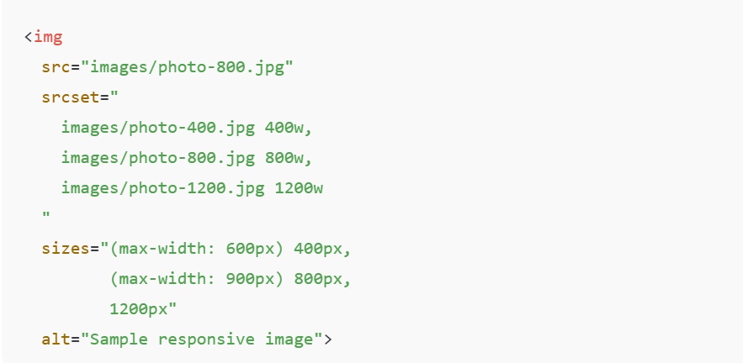
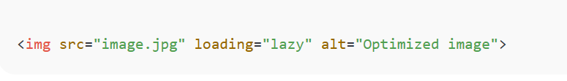
Responsive Image Example

Slide 15
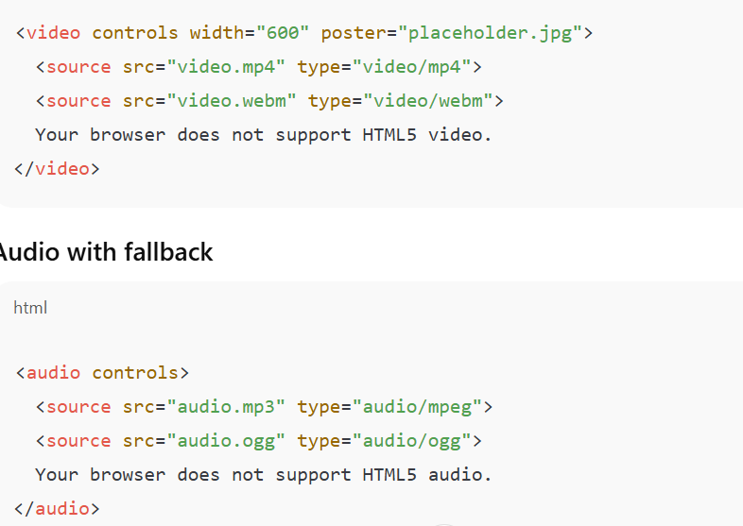
HTML5 Video Example

Slide 16
Inline SVG Example
<svg width="120" height="120" viewBox="0 0 100 100">
<circle cx="50" cy="50" r="40"
stroke="blue"
stroke-width="4"
fill="lightblue"/>
</svg>

Slide 17
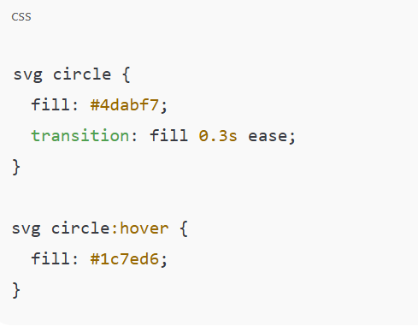
CSS Styling SVG

Slide 18
Simple SVG Animation
<svg width="120" height="120">
<circle cx="60" cy="60" r="40" fill="orange">
<animate
attributeName="r"
from="20" to="40"
dur="1.5s"
repeatCount="indefinite" />
</circle>
</svg>

Slide 19
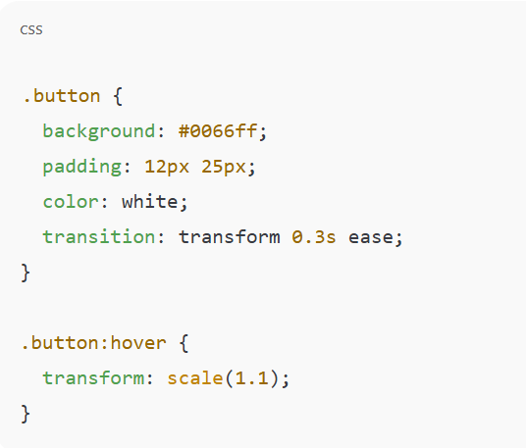
CSS Hover Effect

Slide 20
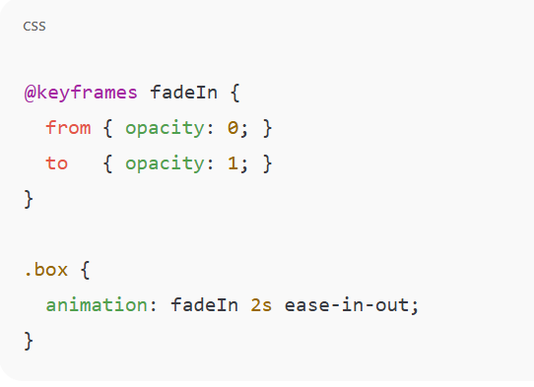
CSS Keyframe Animation

Slide 21
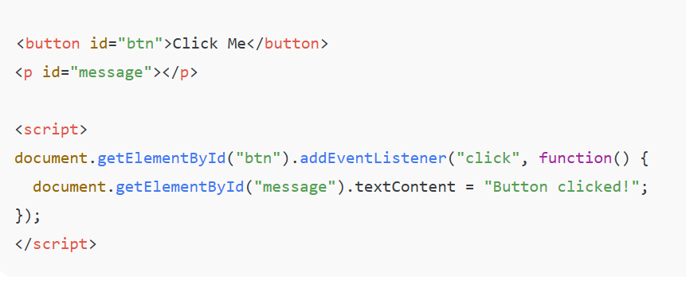
JavaScript Click Event

Slide 22
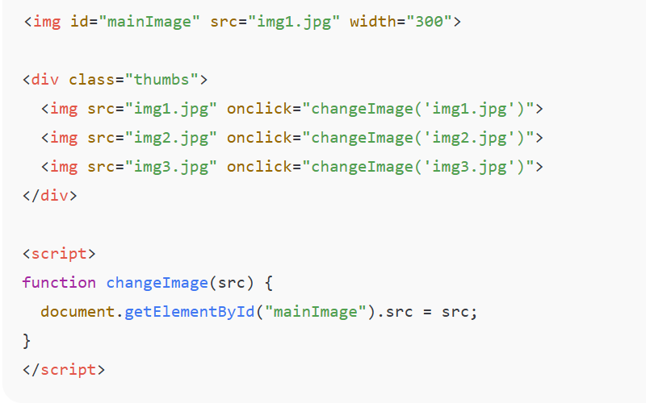
Image Gallery – Change Image on Click

Slide 23
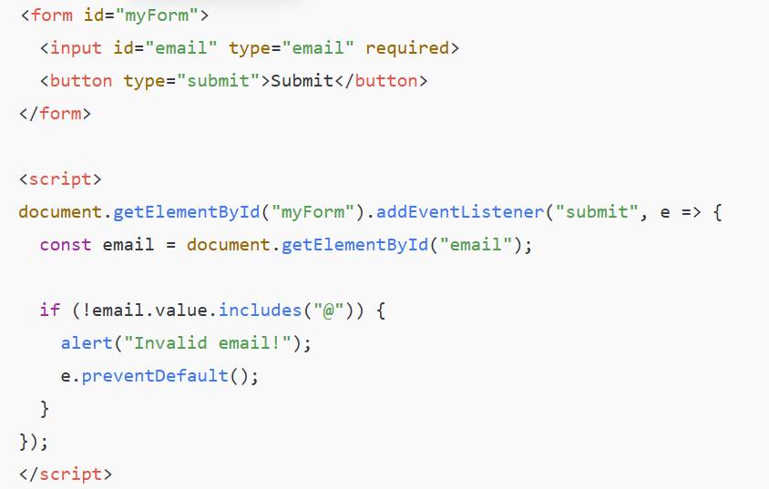
Form Validation (JavaScript)

Slide 24
Conclusion
Multimedia and interactivity greatly enhance user experience
Good optimization improves speed and SEO
SVG supports scalable and modern design patterns
CSS & JavaScript provide powerful tools for interactive UI
Balance creativity with performance and usability

